Slide 1
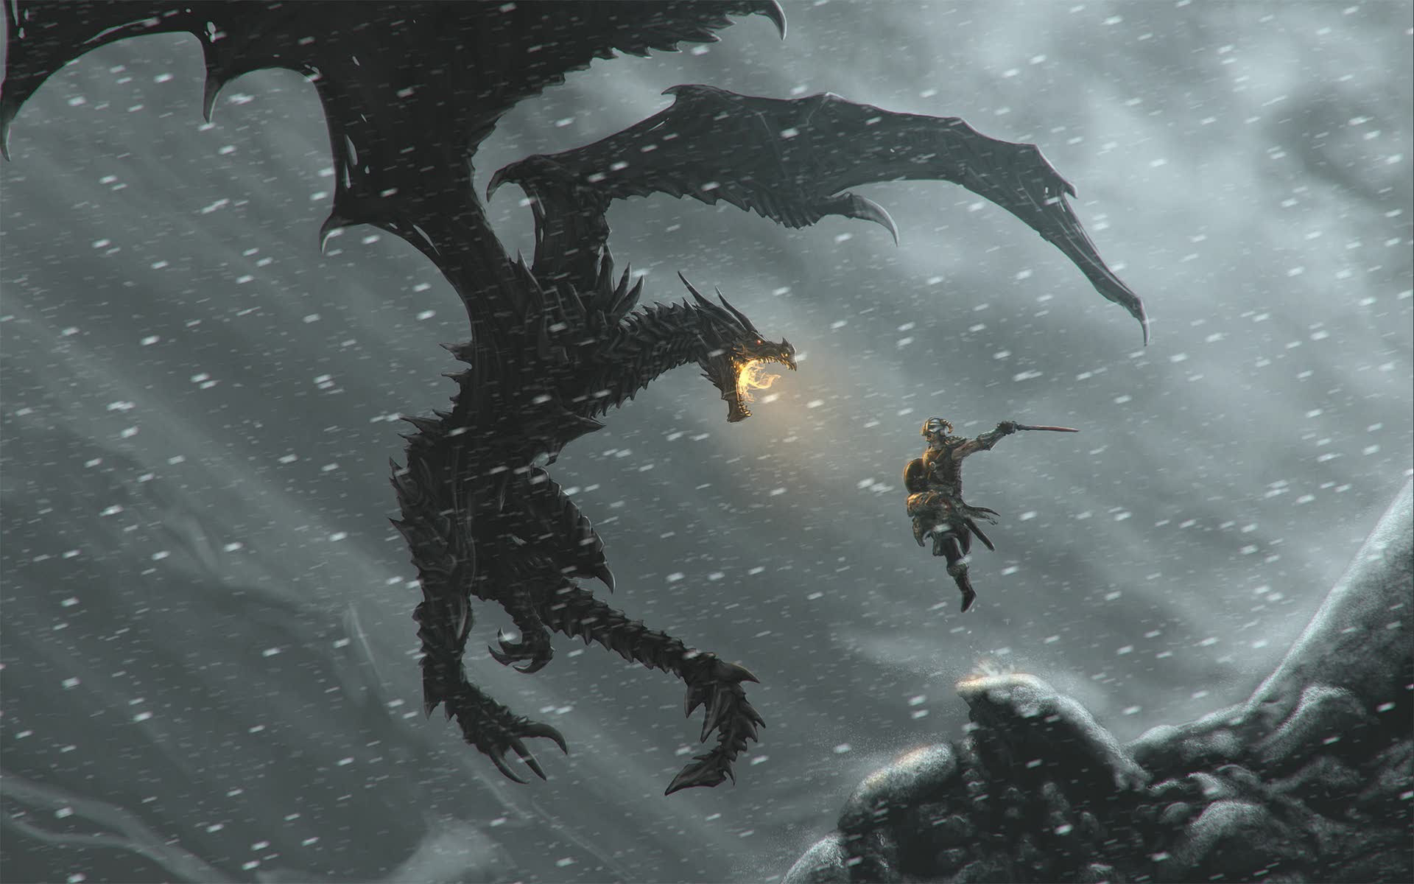
Project Phase I
Group JJNW
Represented by John and Josh

Slide 2

Introduction
What are we creating?
A web application to buy, sell and bid on game content.
Sellers will be able to set the price of the content and potential put items up for free.
A front end for user interaction on top of a backend for processing and database connection.

Slide 3

Functions
Sale items
Items that companies or users put up for sale
Categories
To help organize all items
Video games > Strategy > Single Player
Video games > User created content > Mods > Paid > Skyrim > Weapons > Swords
Merchandise > Collectables > Figurines

Slide 4
Functions
Registered Users
All users must register to sell, bid and buy
Will retain customer information
Suppliers
Must register to sell and auction items
Rating
Users rate each other and suppliers based on sale experience

Slide 5
Other Functions…
Browsing
Searching
Sale
Biding
Order and sales report
Delivery
Shop
Wish list

Slide 6
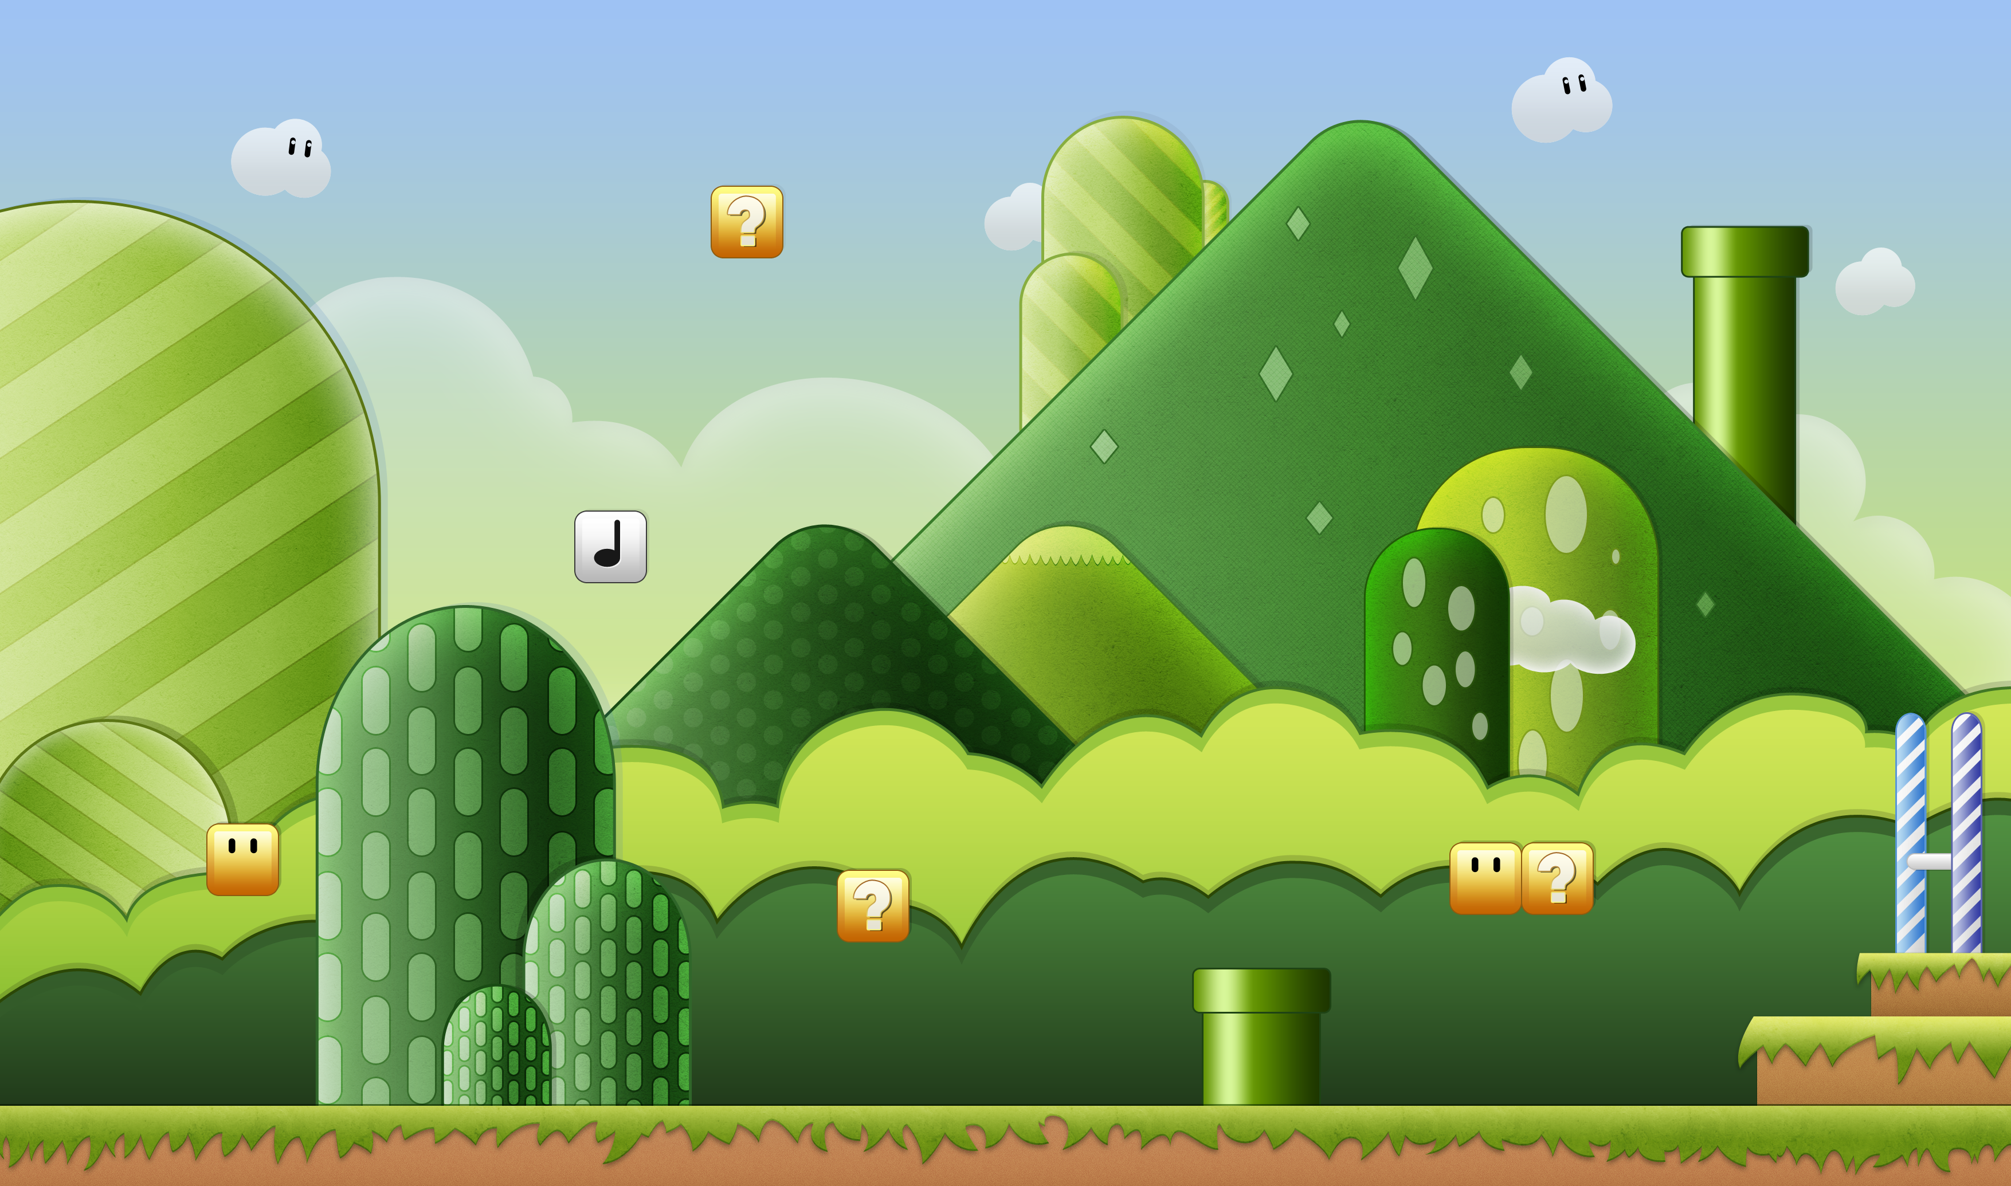
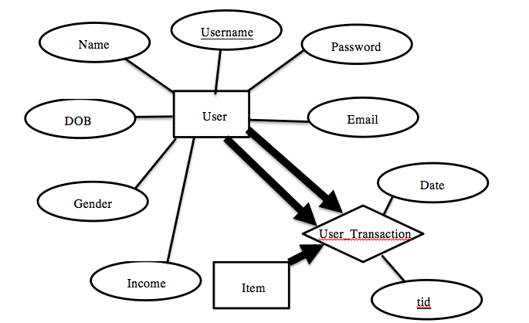
Entity-Relation Diagrams
User Entity and User_Transaction Relationship

Slide 7
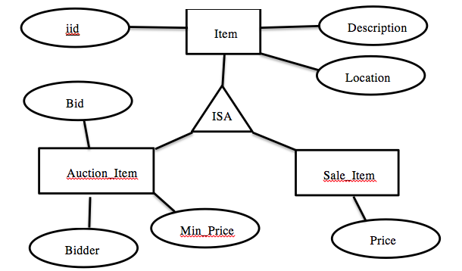
Entity-Relation Diagrams
Item Entity-Relations

Slide 8
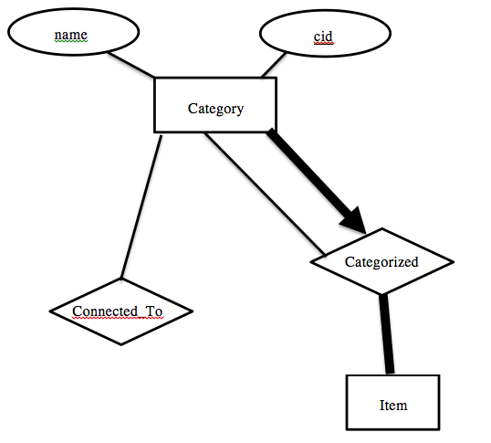
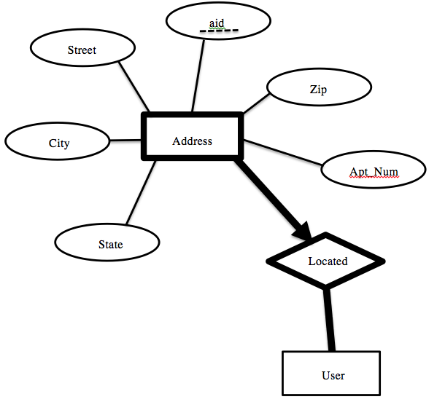
Entity-Relation Diagrams
Category Entity Relationship
Address Entity Relationship

Slide 9
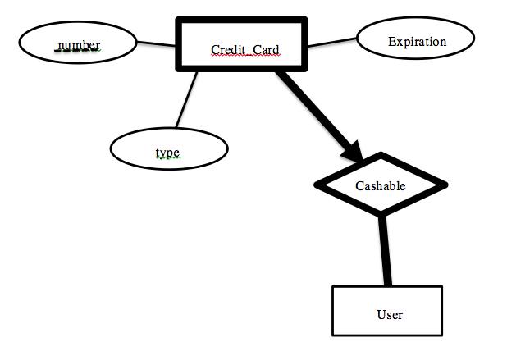
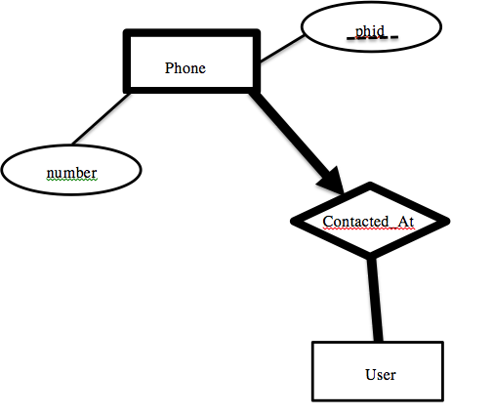
Entity-Relation Diagrams
Phone Entity-Relationship
Credit Card
Entity-Relationship

Slide 10
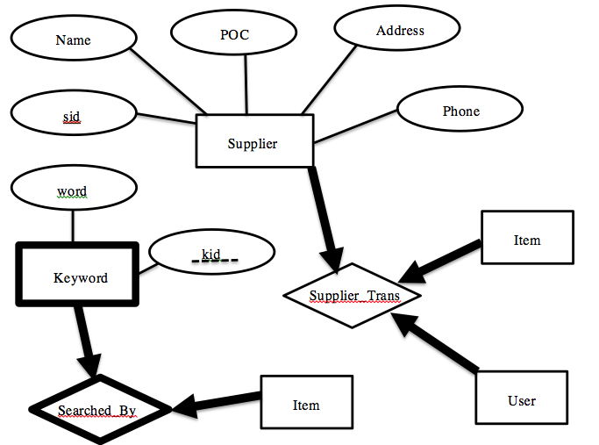
Entity-Relation Diagrams
Supplier Entity-Relationship

Slide 11
Entity-Relation Diagrams
Phone Entity-Relations
Credit Card
Entity-Relations

Slide 12
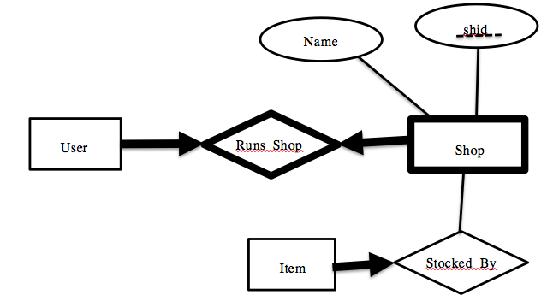
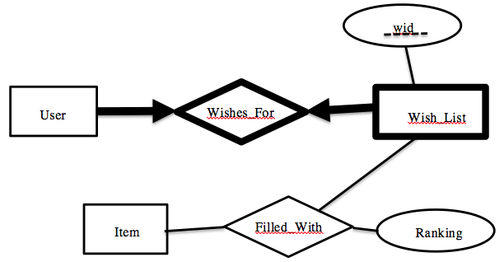
Entity-Relation Diagrams
Shop Entity-Relations
Wish list
Entity-Relations

Slide 13
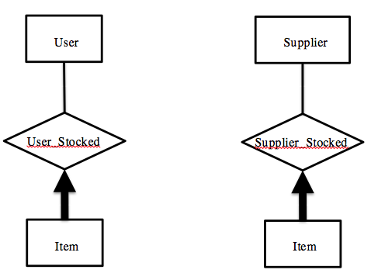
Entity-Relation Diagrams
User Stocked
Entity-Relationship
Supplier stocked
Entity-Relationship

Slide 14
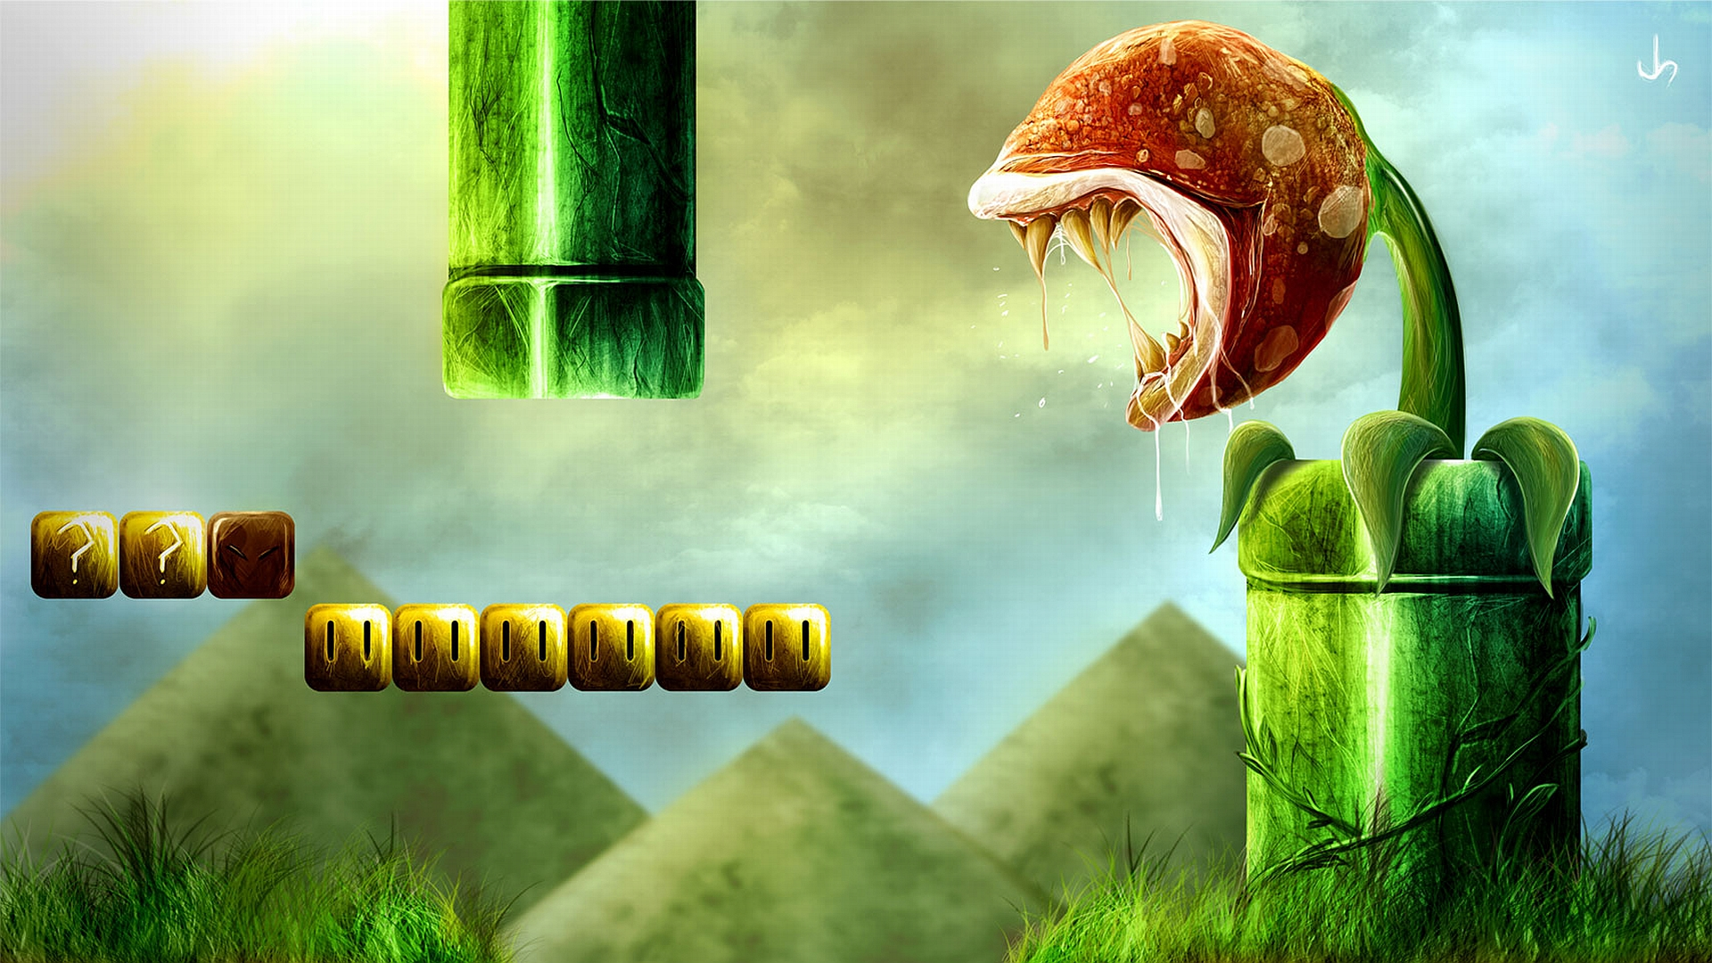
Thank you ☺
JJNW

